Slide 1
ENVIRONMENTAL AUDITING
IN THE ARABOSAI REGION
Challenges and development perspectives
The 9th Seminar on Environmental Auditing
9th Working Meeting of ASOSAI WGEA
23– 25 August 2023, Astana, Kazakhstan

Slide 2
Presentation Overview
1. General Context
2. Environmental audit challenges
3. SAIs individual experiences
4.ARABOSAI SUPPORT
5. Way Forward

Slide 3
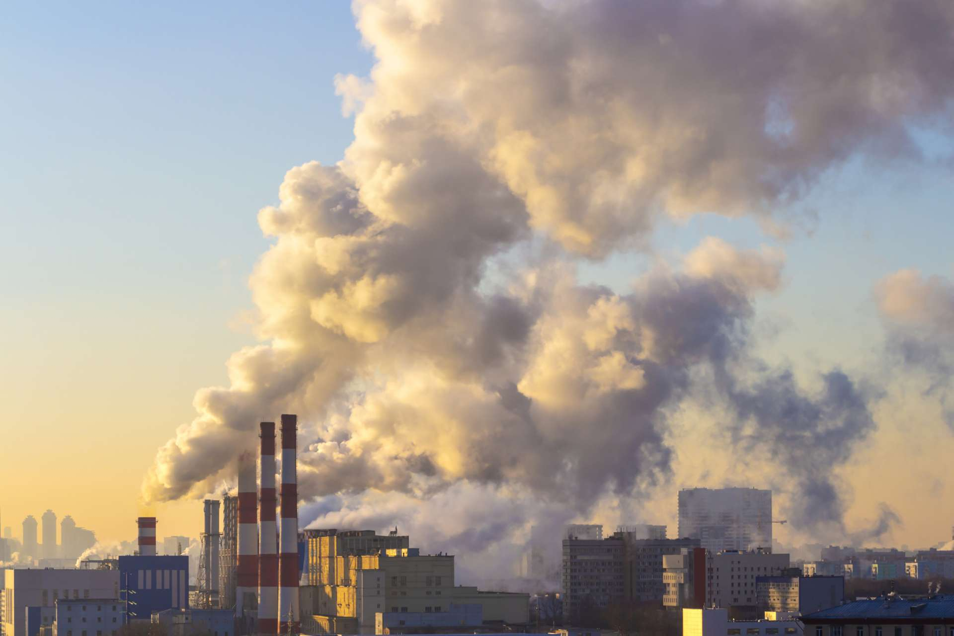
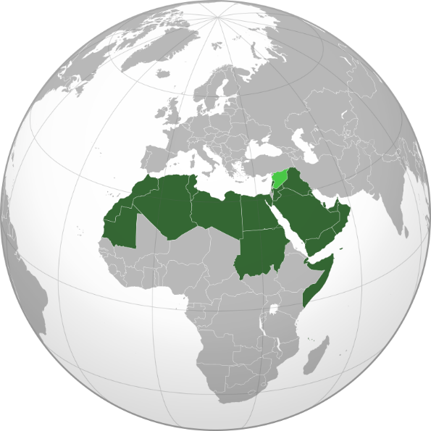
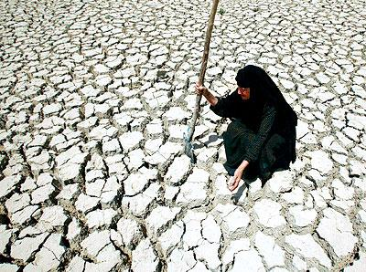
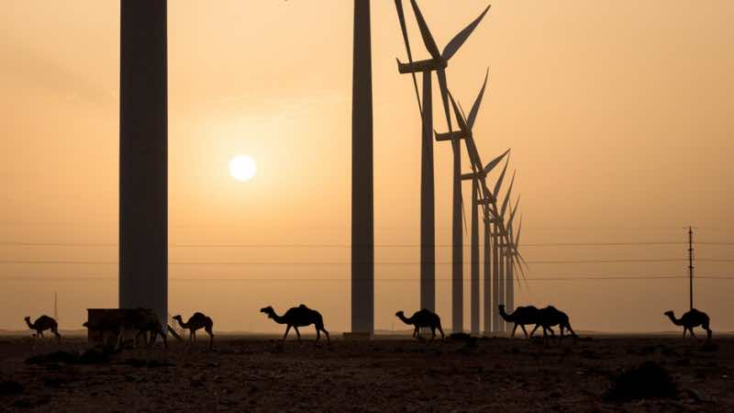
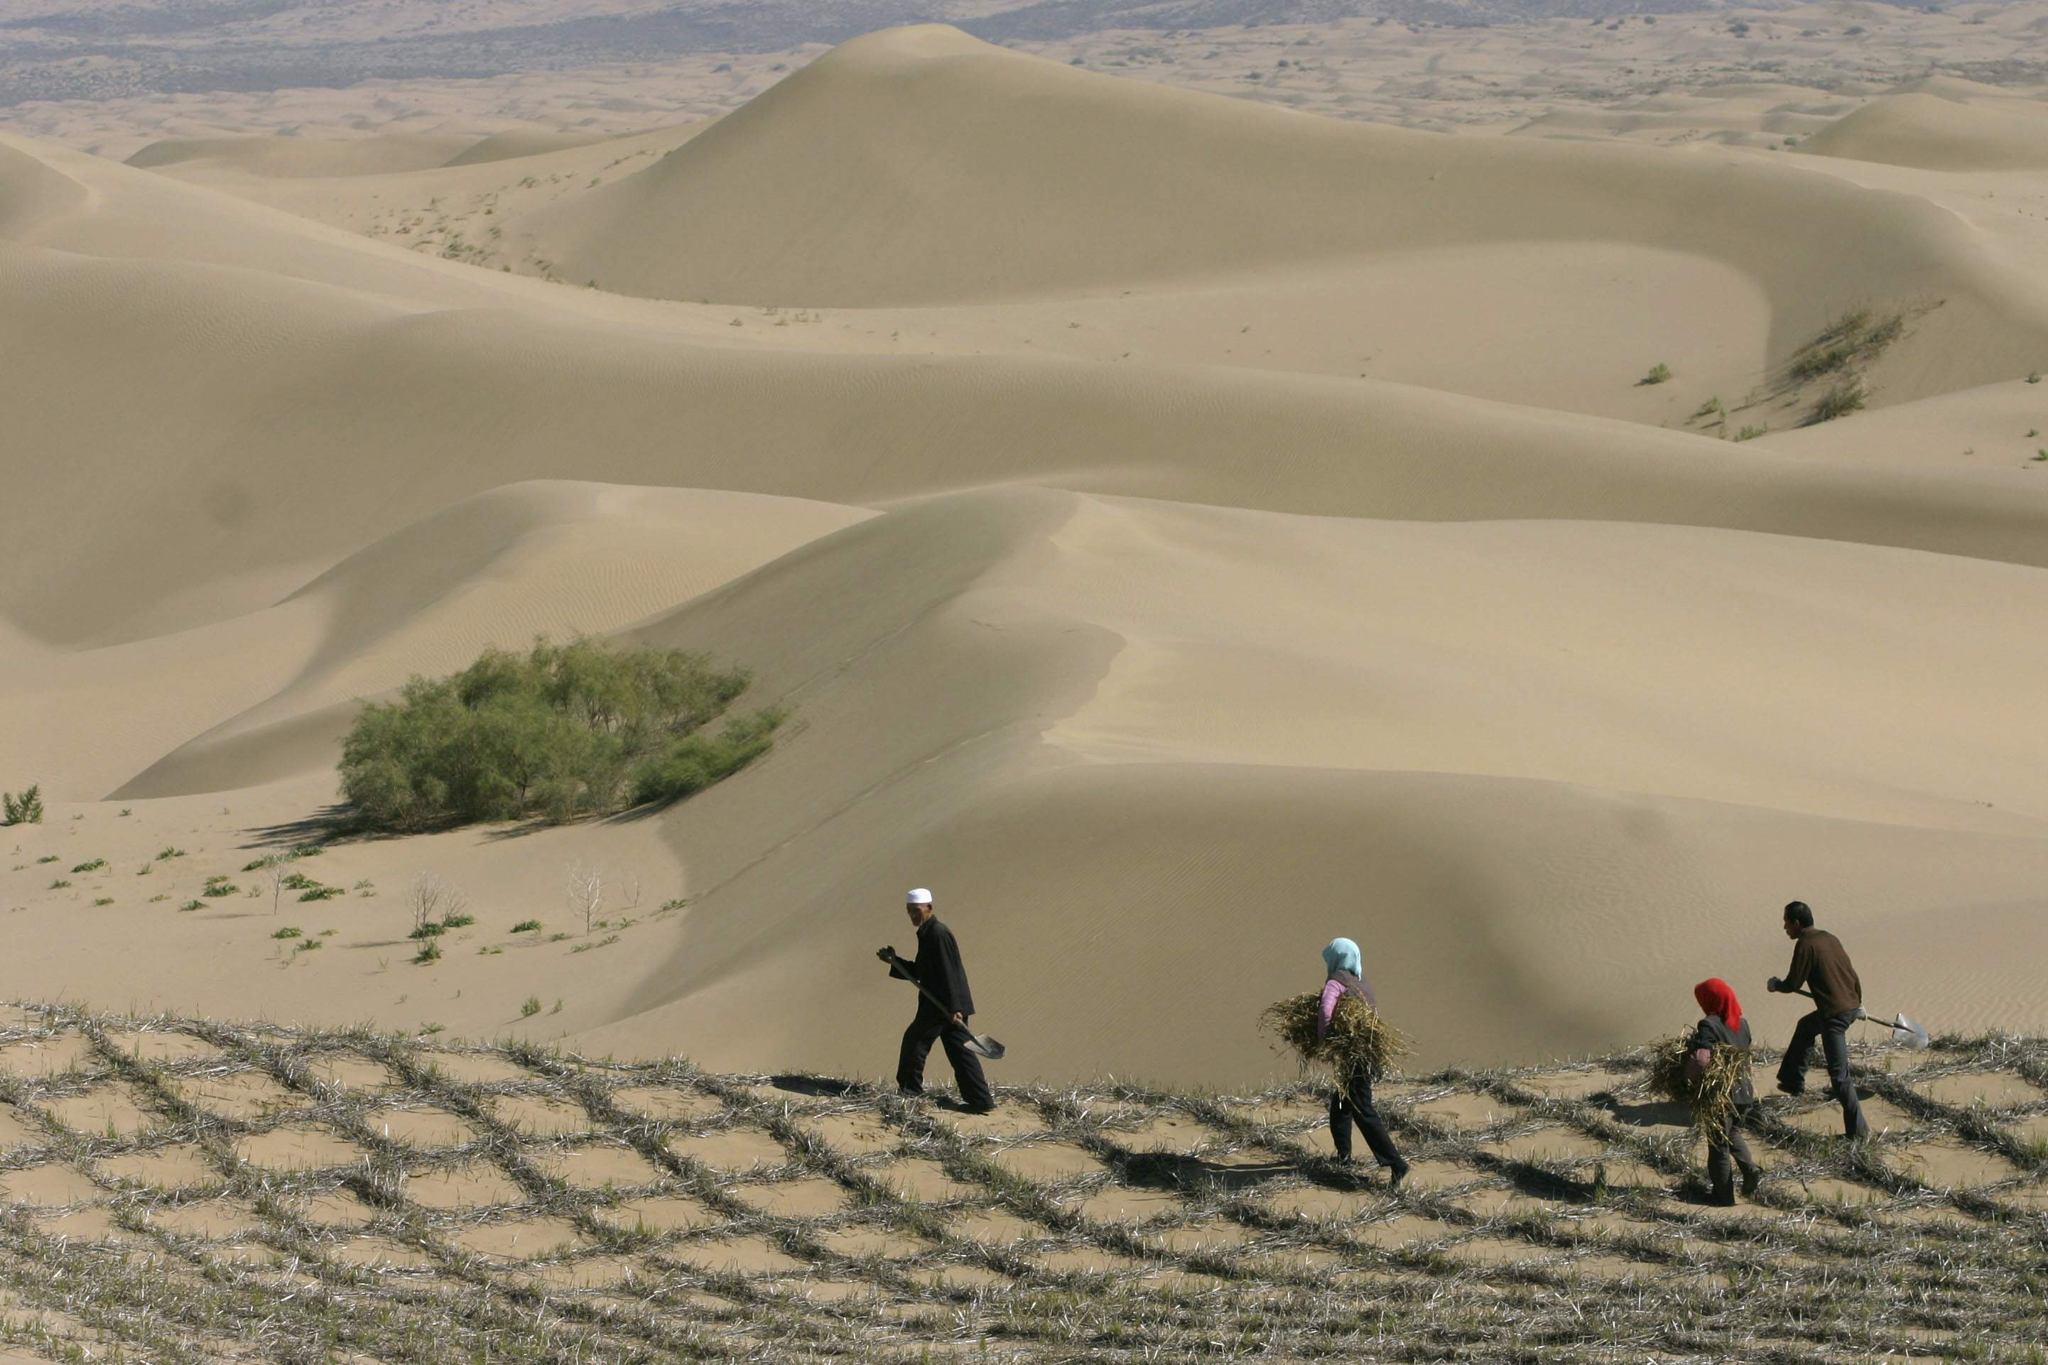
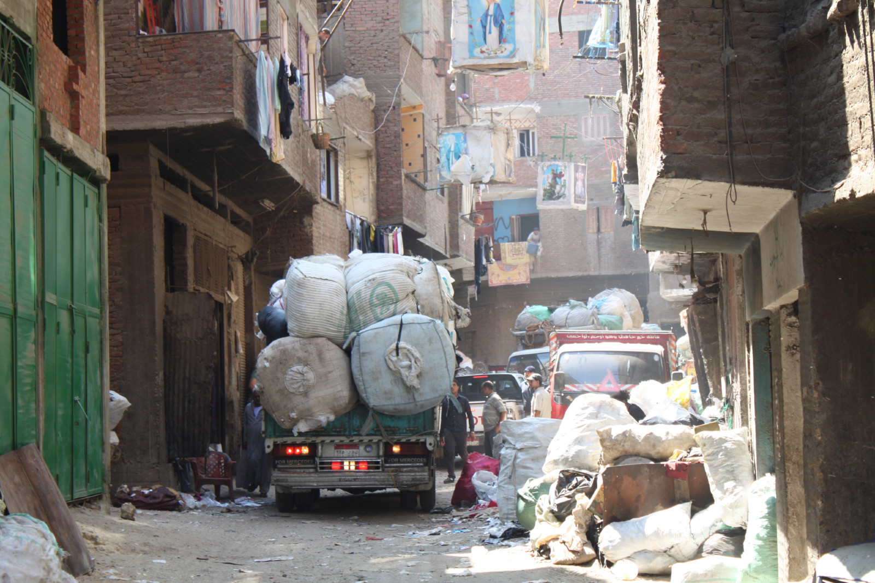
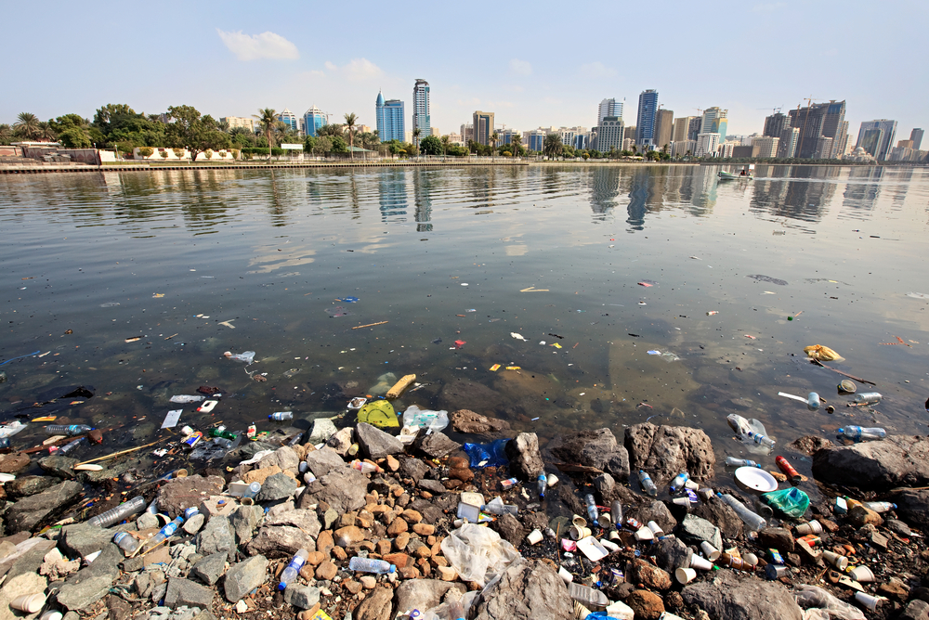
Critical environmental threats and challenges in the region
Water scarcity
Desertification
Climate Change
Impacts of conflicts
Air Pollution
Waste management
Biodiversity loss
Energy consumption and dependence
Rapid urbanization
Coastal Degradation

Slide 4
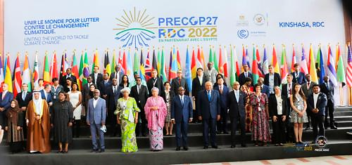
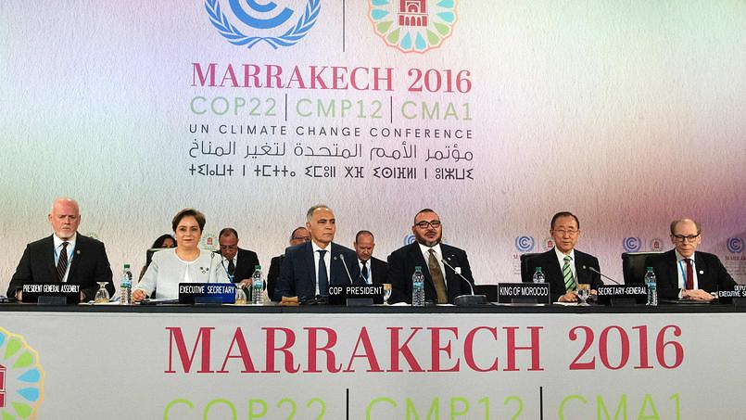
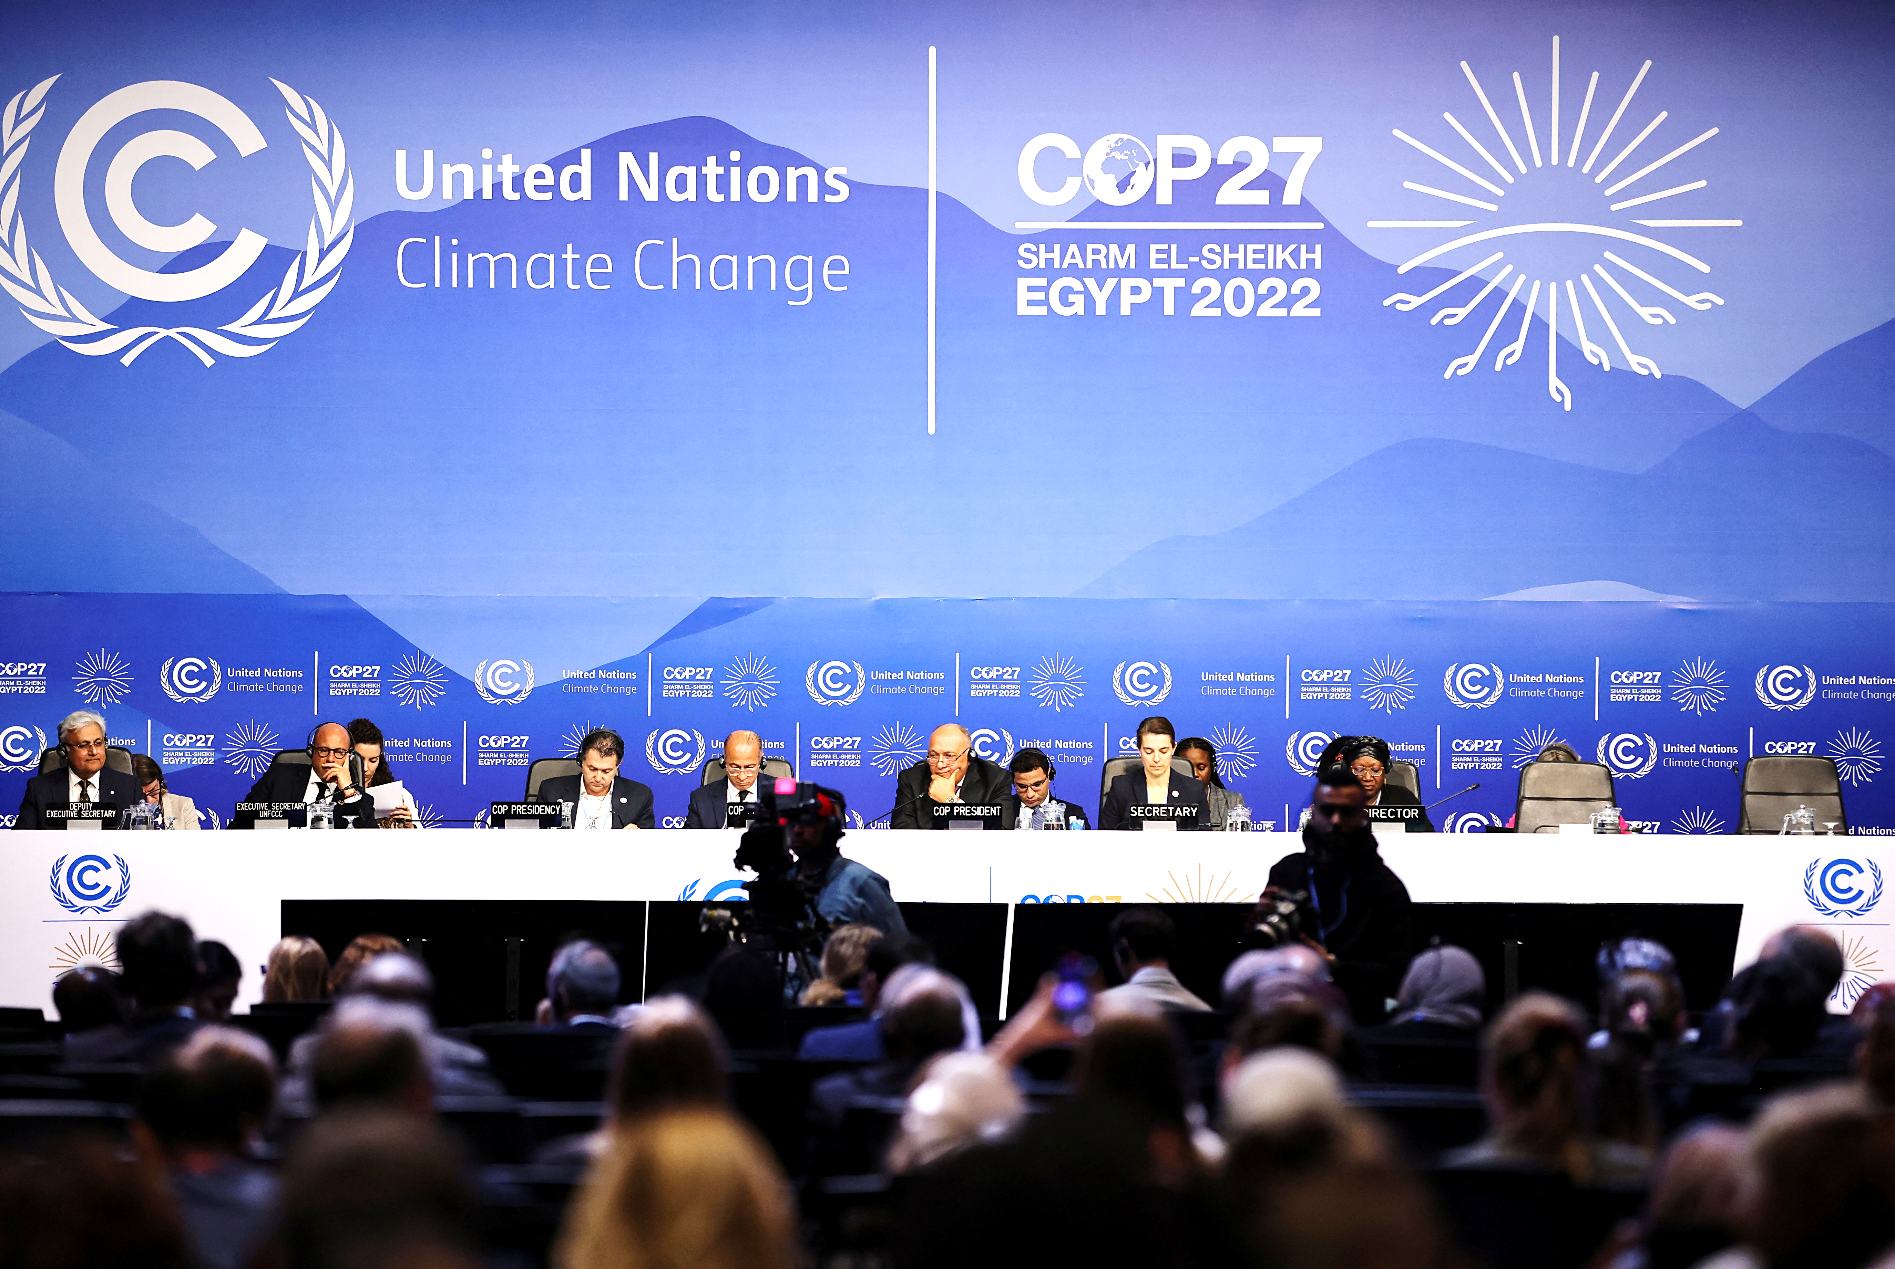
Environmental institutional landscape
Political willingness and international commitment of the Region
G20 summit:
Membership of Saudi Arabia
Countries invited to side events
Conference of the Parties:
COP 18 in Qatar
COP 22 in Morocco
COP 27 in Egypt
COP 18 in Emirates
4
9th Working Meeting of ASOSAI WGEA, Astana, 23– 25 August 2023

Slide 5
Environmental institutional landscape (ctd)
National policies, programs and initiatives
Renewable Energy Targets: "UAE Energy Strategy 2050" with the goal of increasing the share of clean energy to 50% by 2050. Morocco’s renewable Energy strategy,
Water Conservation Measures: Saudi Arabia’s National Water Strategy aiming to reduce water consumption and promote sustainable water management practices.
Desertification Control: Morocco’s "Green Morocco Plan" includes initiatives to protect soils, reduce erosion, and improve agricultural practices.
Waste Management Strategies: "Qatar National Development Strategy 2018-2022" includes plans to enhance waste management infrastructure and increase recycling rates.
Climate Adaptation Plans: Egypt's "National Strategy for Adaptation to Climate Change" aiming to enhance resilience in sectors like water resources, agriculture, and coastal areas.
Protected Areas and Biodiversity Conservation: Jordan's "National Biodiversity Strategy and Action Plan" aims to protect and sustainably manage its unique biodiversity.
Sustainable Tourism: The "Jordan Sustainable Tourism Strategy 2018-2022" focuses on preserving cultural and natural heritage.
Carbon Emission Reduction: UAE’s “National Climate Change Plan of the United Arab Emirates 2017-2050," which includes measures to reduce carbon emissions.
5
9th Working Meeting of ASOSAI WGEA, Astana, 23– 25 August 2023

Slide 6
EA context in the ARABOSAI region
SAIs general context
Government and SAIs models
-Monarchies, Emirates and Republics
-State audit offices
-Jurisdictions (audit courts)
Size of SAIs
From less than 100 staff to more than 3000
Maturity
Audit Capacities
-Insufficient staff
-Challenges in strategic management, ISSAIs implementation, quality management systems, recommendation follow-up systems etc..)
Disparities in terms of institutional, professional and organisational maturity (independence, audit management systems, partnering with stakeholders )
9th Working Meeting of ASOSAI WGEA, Astana, 23– 25 August 2023

Slide 7
EA External challenges for SAI
Legal framework and national standards
Enforcement and compliance
Transparency and Accountability
Research, information quality and technology
Institutional capacities in the auditees (reporting, monitoring, implementation )
9th Working Meeting of ASOSAI WGEA, Astana, 23– 25 August 2023

Slide 8
Examples of SAIs Practices & relevant experiences
Organizational adjustments for SDGs auditing (specialized units, officers and teams in PA departments: Kuwait, Egypt, Lybia, Morocco, Jordan)
On going SAIs projects include: trainings (Lybia, Egypt, Morocco), dedicated operational plans (Jordan), manuals development (Egypt)..
Membership of INTOSAI WGEA
Participation in the “climate scanner” project
Consistent experiences in EA in many SAIs : Kuwait, Egypt, UAE, Qatar, Jordan, Saudi Arabia, Morocco..etc
Clear references in SAIs’ strategic plans to SDGs
Reports on Governments preparedness for 2030 agenda
9th Working Meeting of ASOSAI WGEA, Astana, 23– 25 August 2023

Slide 9
ARABOSAI’s SDGs committee
ARABOSAI WGEA initiated its work in May 2009.
Changed to the “Environmental Auditing Committee”.
The scope of the Environmental Auditing Committee extended to audit sustainable development issues.
Currently, the Committee consists of nine SAIs: Egypt, Iraq, Jordan, Kuwait, Libya, Morocco, Oman, Palestine, and Saudi Arabia.
2023-2025 strategic plan
9th Working Meeting of ASOSAI WGEA, Astana, 23– 25 August 2023

Slide 10
ARABOSAI’s SDGs committee
Programs in the strategic plan 2023-2025
Environmental dimensions of SDGs
Trainings, manuals and guidelines
development
4
Goal 6
activities
Raising
Awairness,
Knowledge
and experience sharing

Slide 11
2023 operational plan
Promoting the participation of SAI members in INTOSAI WGEA projets and activities
Second survey on the status of SDGs auditing
Database for environnemental audit reports
Participation in selected sessions in the ESCWA Forum for Sustainable Development 2023 (special attention to Goal 6 on water)
9th Working Meeting of ASOSAI WGEA, Astana, 23– 25 August 2023

Slide 12
2023 operational plan (ctd)
Translating and adapting manuals and guidelines (ongoing)
Study and evaluate SAIs strategic plans (ongoing)
Trainings of trainers on ISAM model (ongoing)
IDI’s cooperative audit on climate change
A webinar on institutional capacities assessment in the Arab region in partnreship with ESCWA (10 octobre 2023)
Publishing success stories (ongoing)
9th Working Meeting of ASOSAI WGEA, Astana, 23– 25 August 2023

Slide 13
Projects endorsed for the period 2024 -2025
A series of workshop :
PFM Framework in relation with the implementation of the SDGs;
Auditing Goal 6 using the ISAM model
Intensifying SAIs efforts to accelerate the implementation of the 2030 Agenda (Workshops for SAIs leaderships);
Exemplary SAIs,
Cooperative audit on the implementation of the water saving goal (with ISAM model)
International forum on pioneering experiences and good practices in SDGs auditing
9th Working Meeting of ASOSAI WGEA, Astana, 23– 25 August 2023

Slide 14
Portfolio of additional projects
Cooperative audit on clean energy (ISAM model)
Series of reports on SAIs experiences in auditing:
Goals 14 and 15 (life below water and life on land, plastic waste management )
Goal 12: Responsible consumption and production and
Goal 13: Climate change action
9th Working Meeting of ASOSAI WGEA, Astana, 23– 25 August 2023

Slide 15
Way Forward
Rethink SAI-level support
Establish regional P2P
Deliver relevent trainings and other capacity building activities
Climate Scanner
Reinforce collaboration with IDI, INTOSAI WGEA & WGSDGs, AFROSAI, ASOSAI, EUROSAI, ESCWA and development partners
Collaboration with our IT regional working group.
9th Working Meeting of ASOSAI WGEA, Astana, 23– 25 August 2023

Slide 16
For contacts & further information
ARABOSAI official website
Court of accounts of the Kingdom of Morocco
The SDGs committee chairman
ARABOSAI representative of INTOSAI WEGA ARABOSAI secretariat-General
www.arabosai.org
ccomptes@courdescomptes.ma
Idriss.aziz@courdescomptes.ma
marouene.hannachi@arabosai.or
contat@arabosai.or

